Slide 1
Skandhas/khandhas

Slide 2
The Twelve Nidānas (Pali/Sanskrit: nidāna "cause, foundation, source or origin") are an application of the Buddhist concept of pratītyasamutpāda (dependent origination). They identify the origin of dukkha (suffering) to be in avijja (ignorance).

Slide 4
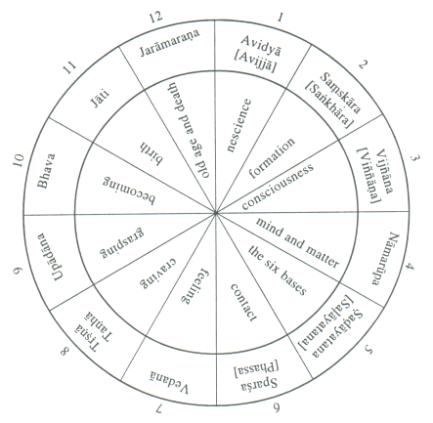

Slide 6
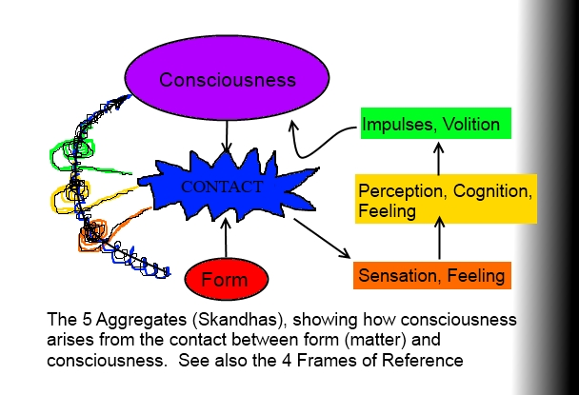

Slide 7
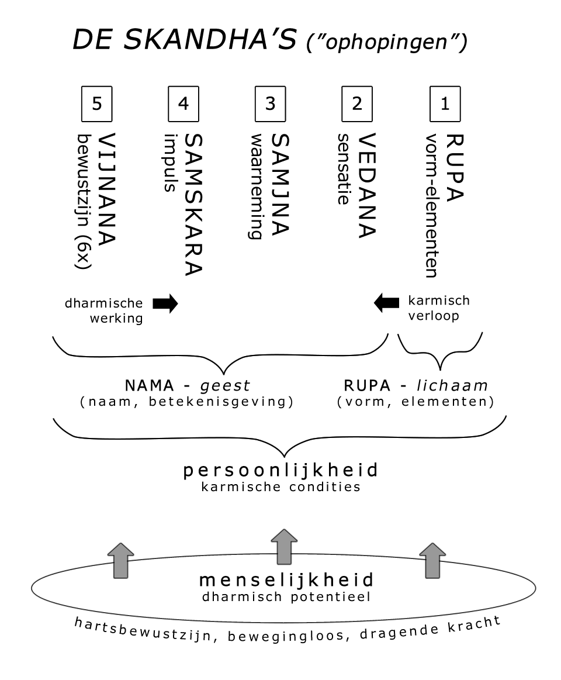

Slide 8
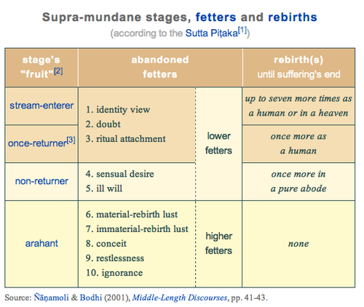

Slide 9
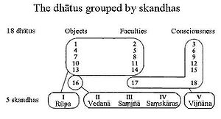

Slide 10
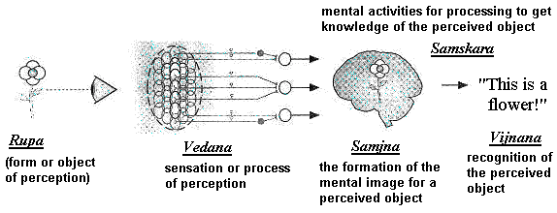

Slide 11
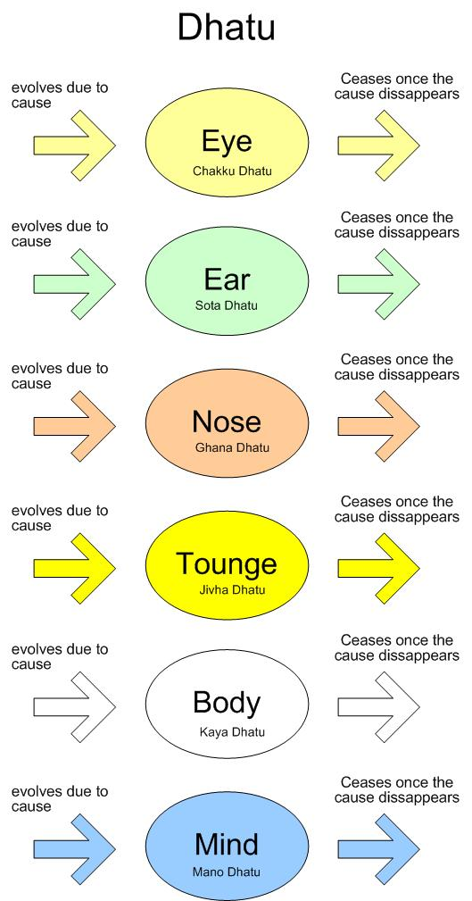

Slide 12
