Slide 1
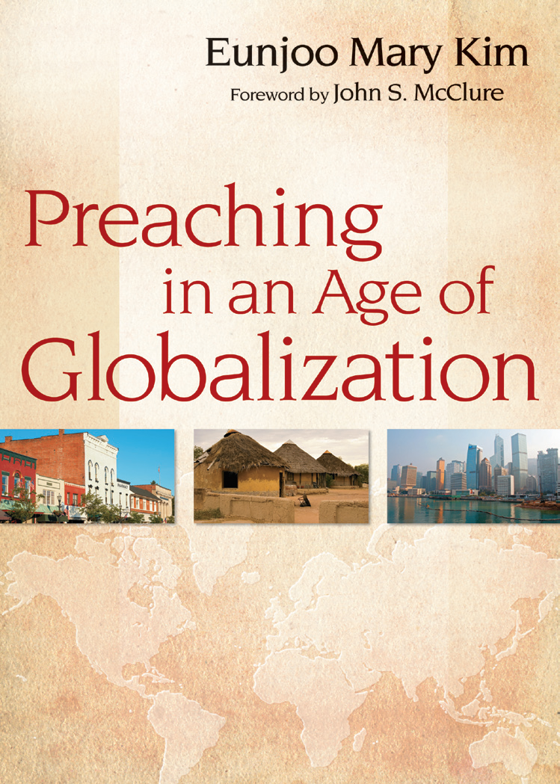

Slide 2
I. Defining the Term Globalization
Globalization:
a “process” or a “trend” becoming global.

Slide 3
II. Dimensions of Globalization: 1. Cultural Diversity and Identity of the Church
Multiculturalism in Society
Multiculturalism in the Church
Identity of the Church: Theology of Solidarity (Galatians 3: 26-28).
Solidarity: mutual support among unequals.

Slide 4
II. Dimensions of Globalization: 2. Neoliberal Capitalism and the Essence of the Christian Gospel
The Ideology of Neoliberal Capitalism
Neoliberal Capitalism and the Church
Challenges of the Christian Gospel: The Theology of the Cross (Colossians 1:15)

Slide 5
Theological and Biblical Issues
What does the Bible say about humanity?
Who are we in the sight of God?
What is the biblical concept of human well-being
or happiness?
What does God say through prophets in the Old Testament
about human possessions?
What does Jesus teach about wealth and poverty?
Does the Bible offer insight into developing an alternative model of the global economy?

Slide 6
II. Dimensions of Globalization: 3. Ecological Crisis and Holistic Healing
The Theory of Domination (Genesis 1:28)
The Theory of Stewardship (Genesis 2:15)
Asian Cosmology/The Theory of Partnership (Roman 8:22; Job 38; Revelation 21, etc.)

Slide 7
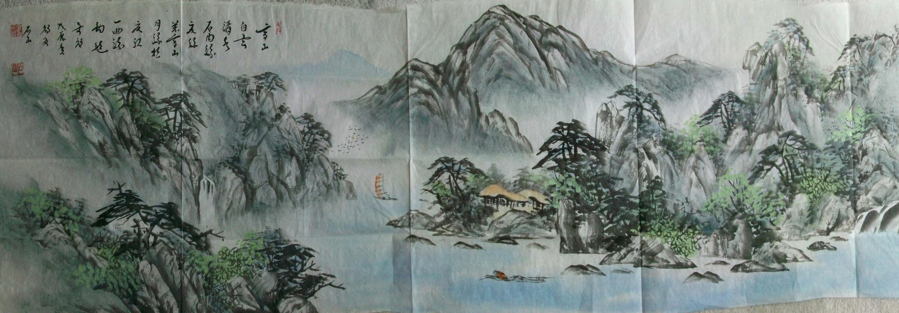
Artist: Suk San, Kim Young chul

Slide 8
III. Preaching as the Politics of God: Invitation to Humanization
Humanization:
a communal process toward the liberation of God’s creatures on earth.

Slide 9
III. Preaching as the Politics of God
Politics: the study of the form of human community for a people to be able to pursue the most ideal mode of life.
The Politics of God: An activity of and reflection on what God is doing in the world to make and keep human life human (Paul Lehmann).

Slide 10
Questions and Comments

