Slide 1

The Process of Spiritual Care
1. Building trust
2. Empathically understanding the care seeker’s moral stress
3. Helping care seekers explore spiritual coping that enhances a sense of safety
and the experience of goodness
4. Helping care seekers identify fear-based values/beliefs/ways of coping, and shift from fear to compassion in ways that increases integration, flexibility, tolerance of ambiguity, and the experience of goodness

Slide 2
Markers of Spiritual Integration
1. GOODNESS & JUSTICE
is experienced and lived out; not
punitive judgment w/o justice
2. COMPLEX MEANINGS of suffering
for persons/communities/creation,
not simplistic meanings
3. FLEXIBLE not rigid
4. INTEGRATED not disintegrated
or compartmentalized
Pargament, K. I., Desai, K. M., & McConnell, K. M. (2006). Spirituality: A pathway to posttraumatic growth or decline? In L. G. Calhoun & R. G. Tedeschi (Eds.), Handbook of posttraumatic growth: Research and practice (pp. 121-135). Mahwah, NJ Erlbaum.
Beliefs
Coping Practices
Values
Emotions

Slide 3
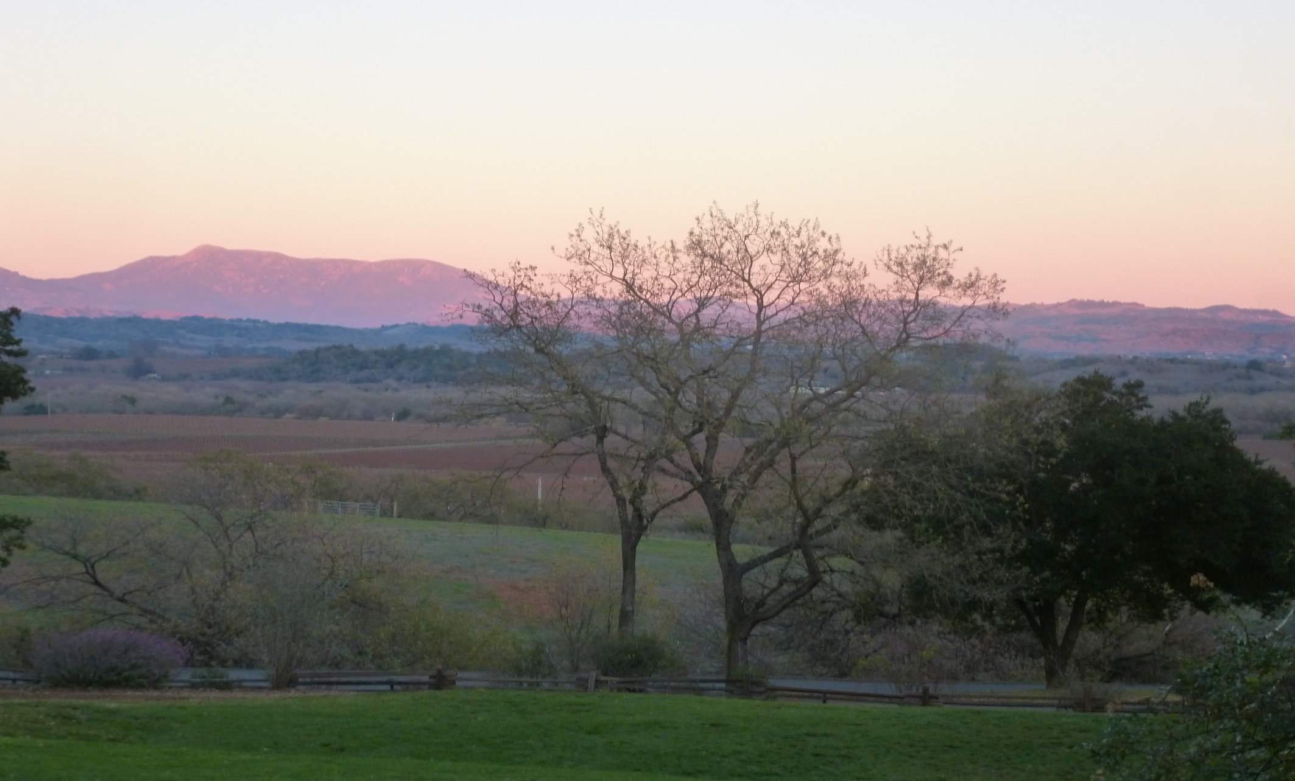
Liberative Spiritual Integration for All
CREATION
COMMUNITIES
FAMILIES
Beliefs
Coping/Practices
Values
PERSONS
Emotions

Slide 4
HOW?
Beliefs
Practices
Values
How does spiritual care help people change and become
more spiritually integrated
in liberative ways
for themselves,
their families,
society and creation?

Slide 5
SPIRITUALLY- INTEGRATED CHANGE
Radical Respect
Compassion
Theological reflexivity

Slide 6
Radical Respect for Differences
Respect irreducible differences without searching for “one God”
Focus on lived practices, values, and beliefs
Dialogue with full awareness of biases & “intractable otherness”
Moyaert, M. (2012). Recent developments in the theology of interreligious dialogue: From soteriological openness to hermeneutical openness. Modern Theology, 28(1), 25-52.

Slide 7
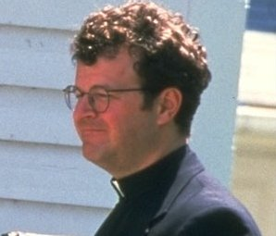
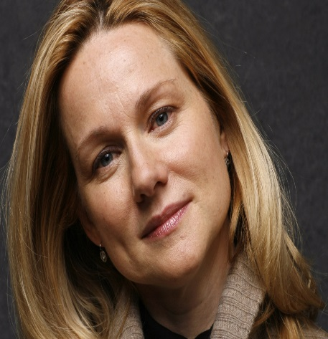
Compassion
COMPASSION for each person’s contextual & narrative truth
Relational Foundation of Caregiving

Slide 8

Compassion: Antidote to Fear
COUNTERACTS
FEARS
COMPASSION
Notes:
Mindfulness mediation helped these veterans internalize a sense of self-compassion that counteracted embedded beliefs that they had failed morally in some way.
These Vietnam veterans have found Buddhist spiritual practices, communities, and worldviews that they actively use to counteract traumatic symptoms, lament radical suffering, and reclaim goodness that encompasses the ambiguities and finitude of life.

Slide 9
Watching Sammy’s Conversation with Pastor Ron
One hour; 16 minutes into movie

Slide 10
Sammy (1): So, uh, what is the church’s official position on fornication and adultery?
Ron (1): Well, it’s a sin. (slowly)
Sammy (2): Good, I think it should be.
Ron (2): But we try not to focus too much on that right off the bat.
Sammy (3): Why not? Maybe it was better if you told me I was endangering my immortal soul and that if I don’t quit I’m going to burn in hell. Did you ever think about it?
Ron shrugs and shakes his head.
Sammy (4): And isn’t it better than all of this ‘why do you think you’re in this situation’ psychobabble.
Ron (4): Why do you think you’re in this situation?
Sammy (5): Because I feel sorry for them (referring to all of the men who are central in her life: Brian, her boss; Bob, whom she has been dating and who has just proposed to her; and her brother). Isn’t that ridiculous? (She shakes her head.)

Slide 11
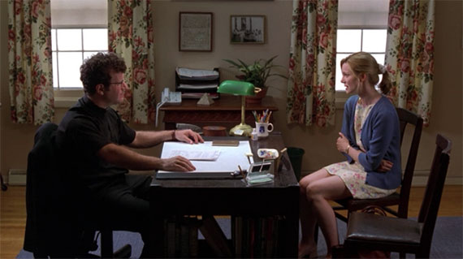
Relational Foundation of Care
COMPASSION
COUNTERACTS FEAR
HOLDS ANGER
Notes:
Mindfulness mediation helped these veterans internalize a sense of self-compassion that counteracted embedded beliefs that they had failed morally in some way.
These Vietnam veterans have found Buddhist spiritual practices, communities, and worldviews that they actively use to counteract traumatic symptoms, lament radical suffering, and reclaim goodness that encompasses the ambiguities and finitude of life.

Slide 12
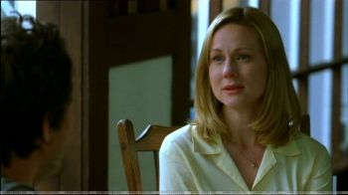
Compassion: Deep Grammar
Notes:
Self-compassion gave him new ways to integrate and understand a self-narrative previously fragmented by fear and anger, and an underlying dynamic of shame.
He began to author his self-narratives with self-compassion, which fostered spiritual integration and flexibility, and complexity of meanings that took into account the ambiguous and interconnected relational and cultural webs.

Slide 13
SPIRITUAL ORIENTING SYSTEM
Coping: Sexual relationship with boss; seeking pastoral care
Beliefs:
God punishes sinners
Suffering results from personal sin
Values:
Responsibility
Fear, Anger
Underlying Shame

Slide 14
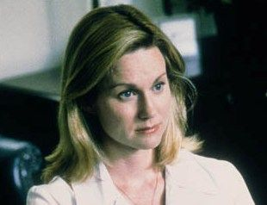
Compassion
ANGER
FEAR
Underlying
SHAME
Notes:
Self-compassion gave them new ways to integrate and understand a self-narrative previously fragmented by fear and anger, and the underlying dynamic of shame.
They began to author their self-narratives with self-compassion, which fostered spiritual integration and flexibility, and complexity of meanings that took into account the ambiguous and interconnected relational and cultural webs in which they were caught as young soldiers.

Slide 15
SPIRITUALLY- INTEGRATED CHANGE
Radical Respect
Compassion
Theological reflexivity

Slide 16
A Process of Theological Reflexivity
1. Caregivers and care seekers collaboratively identify the physical stress responses and emotions that trigger and energize the care seeker’s spiritual orienting system, using spiritual practices to embrace stress.
2. They explore the emotional and narrative logic that dynamically connects particular beliefs/values with habitual ways of coping.
3. They use a process of theological reflexivity to assess what is life-giving and life-limiting about these lived theologies/spiritual orienting systems.
Beliefs
Coping/Practices
Values
Emotions: Fear? Anger? Compassion?

Slide 17
Theological Reflexivity
Respect & compassion for Sammy’s alterity
ORIENTING
SYSTEM
SPIRITUAL PRACTICES
Co-constructed contextual theologies
VALUES
BELIEFS
TRUST/COMPASSION

Slide 18
An Intersubjective Co-creation
CAREGIVER’S ORIENTING
SYSTEM
ORIENTING SYSTEM OF CARESEEKER
SPIRITUAL PRACTICES
VALUES
BELIEFS
They co-create unique meanings within an intersubjective space

Slide 19
Discovering Compassion-Based Orienting Systems
When care seekers experience this compassionate, theologically reflexive process
they often discover possibilities for
spiritual practices fostering self-compassion
that give birth to life-giving constellations
of beliefs, values, and practices.
Such spiritual practices can also help them identify and resist the emotional triggers that make them enact life-limiting orienting systems.

Slide 20
Spiritual Orienting Systems/Religious Faith
COPING/SPIRITUAL PRACTICES
VALUES
BELIEFS
FEAR AND ANGER
UNDERLYING SHAME
Notes:
A practical theological method that
allows the veterans’ unique values, beliefs, and spiritual practices to emerge and then
brings these spiritual or existential orienting systems into dialogue with various public theologies and worldviews which have stood the test of time.

Slide 21
Relational Foundation of Care
COUNTERACTS FEAR
HOLDS ANGER
COMPASSION
UNCOVERS SHAME
FOSTERS ACCOUNTABILITY
Notes:
Mindfulness mediation helped these veterans internalize a sense of self-compassion that counteracted embedded beliefs that they had failed morally in some way.
These Vietnam veterans have found Buddhist spiritual practices, communities, and worldviews that they actively use to counteract traumatic symptoms, lament radical suffering, and reclaim goodness that encompasses the ambiguities and finitude of life.

Slide 22
Existential Jigsaw Puzzle
ANGER
FEAR
REGRETS
GUILT
COMPASSION
Notes:
Self-compassion gave them new ways to integrate and understand a self-narrative previously fragmented by shame.
They began to author their self-narratives with self-compassion, which fostered spiritual integration and flexibility, and complexity of meanings that took into account the ambiguous and interconnected relational and cultural webs in which they were caught as young soldiers.

Slide 23

Spiritual Orienting Systems/Religious Faith
COPING/SPIRITUAL PRACTICES
VALUES
BELIEFS
Compassion, Sadness, Healthy Guilt & Regrets

Slide 24
Compassion: Key to Change
Compassion-based
Values, Beliefs, Coping
Compassion:
Experienced through emotional/spiritual not sexual intimacy
Notes:
1. Experiencing compassion through spiritual and emotional intimacy, not sexual intimacy counteracts his fear- and anger-based spiritual orienting system.
2. Allowing him to experience and integrate a compassion-based approach to suffering.
In other words, compassion becomes a performative theology (E. Graham, 1996) which helps him become accountable for suffering he has caused and is now experiencing.

Slide 25
Theological Reflexivity on Redemption
Compassion-based approach
Childhood punitive theology
Compassion
Fear & anger
Notes:
The lived theology of these veterans helped us see how often our culture in the United States responds to catastrophic suffering by prematurely focusing on healing and themes of redemption from our Christian heritage. Buddhist practices, teachings, and communities provided these veterans with an alternative to commonly used redemptive theologies of suffering. We need to monitor how embedded theologies of redemptive suffering are often used to understand trauma.

Slide 26

Self Transcendence: Key to Change
Compassion, acceptance of death
Self-Transcendence: Experienced through the beauty of nature
Notes:
1. Experiencing compassion through Buddhist meditative practices counteracts an embedded moral theology (suffering is God's punishment for individual wrongdoing).
2. Allowing them to integrate a Buddhist worldview of suffering.
In other words, compassion becomes a performative theology (E. Graham, 1996) which helps them articulate and live out Buddhist understandings of suffering in more complex interconnected ways rather than individualistic moral ways.

Slide 27
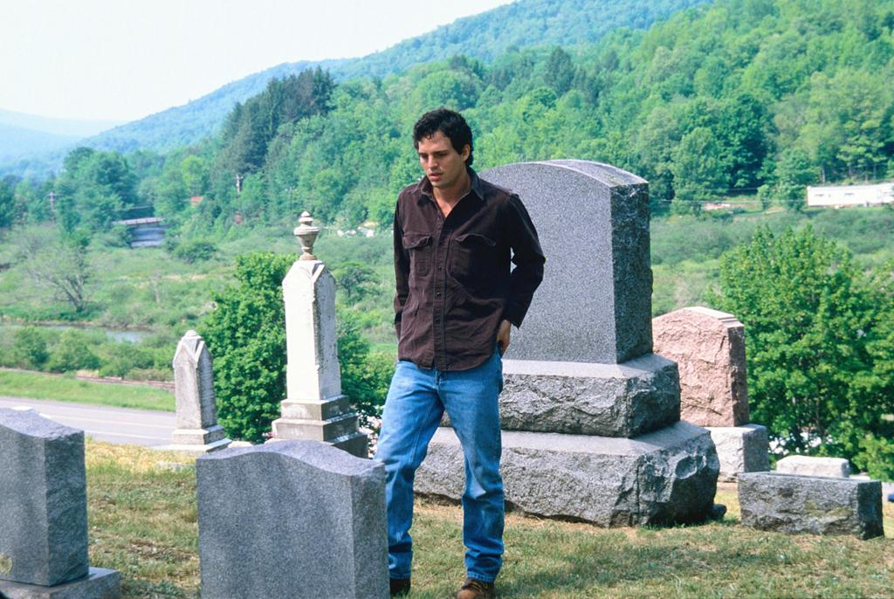
Self Transcendence: Key to Change
Compassion
Acceptance of death
Self-Transcendence: Experienced through the beauty of nature
Notes:
1. Experiencing compassion through Buddhist meditative practices counteracts an embedded moral theology (suffering is God's punishment for individual wrongdoing).
2. Allowing them to integrate a Buddhist worldview of suffering.
In other words, compassion becomes a performative theology (E. Graham, 1996) which helps them articulate and live out Buddhist understandings of suffering in more complex interconnected ways rather than individualistic moral ways.

Slide 28
Theologically Understanding Stress
As chaplains and pastoral caregivers we can draw upon our theological expertise in helping people assess the consequences of the theologies of stress inherent in their values and beliefs, especially embedded theologies from childhood.
Our religious and theological education gives us an historical and comparative understanding of various religious and theological ways that people have tried to make sense of and live with stress and suffering.

Slide 29
Moral Ways of Understanding Stress
God: all good and all powerful.
Suffering and stress :
results from human beings having free will and making choices that are constructive or destructive (sinful).
is a consequence of/punishment for personal wrongdoing (embedded childhood beliefs). Capitalist Karma is the belief that financial success is the result of hard work. Financial stress is a consequence of not working hard enough.
has the potential to teach us lessons about life, and is “soul-making.”

Slide 30
Moral Theologies of Stress
(+) most relevant in a crisis where there is clear wrong-doing for which people need to take responsibility.
(+) for people want a clear map of right and wrong to reassure themselves that the world is a safe place and there are rules/worldviews that can be used to help people get through each day/hour
(+) for people ready to take a moral inventory in order to make amends
(-) for people who feel overly responsible; who easily blame themselves

Slide 31
Redemptive Suffering
Jewish theologies: God and humanity are in a covenantal relationship that potentially redeems stress
Christian theologies: God was incarnated, became human, suffered like us showing us that nothing can separate us from God’s redeeming love.
Stress: sometimes can eventually result in people experiencing and reclaiming a sense of goodness.
The Jewish symbol of the exodus and the Christian symbol of the cross represent the compassion and life-renewing presence of God who can bring new life out of death.

Slide 32
Pluses and Minuses
(+) for people retrospectively looking back, who have been able to reclaim goodness in spite of stress and suffering.
(+) for people who stay connected in a relational web that sustains them and may eventually help them reclaim goodness
(-) for people who bear stress like a private cross of suffering, hoping that by themselves, they will be able to redeem stress and suffering.

Slide 33
Eschatological Suffering
Moments of hope that point to a future when stress will be alleviated: God will bring all stress and suffering to an end.
(+) people who seek out and find spiritual practices that provide hope amidst overwhelming stress
(-) for people who passively endure stress when they could be taking action of some kind (finding spiritual practices, seeking help)

Slide 34
Radical Suffering and Stress: Lament
God: struggles with us and hears our protests and our questions
Some kinds of stress result in irreparable loss and have no purpose. All we can do in response is protest and lament.
(+) for people who need to express lament and rage, especially in community with others.
(-) for people who get stuck in questioning God and in spiritual struggle.

Slide 35
Ambiguous Creation
God: is a relational God, in the process of becoming
Stress is like suffering in the sense that
“Some suffering and conflict are in fact part of the design [of creation]” (Nelson, 2003, p. 405).
Stress is often complex, ambiguous and tragic, with multiple intertwined causes (biological, psychological, familial, communal, cultural, cosmic)
(+) for people who embrace a sense of mystery that allows for complexity in the midst of intense stress, and in the long-term meaning-making process.
(+) for people who know there is no single cause for their stress
(-) for people who get lost in the mystery and can’t connect with God/goodness.

Slide 36
Exploring these 5 paradigms of suffering in terms of values: http://www.moralfoundations.org/
Six clusters of moral concerns—care/harm,
fairness/cheating,
liberty/oppression,
loyalty/betrayal,
authority/subversion, sanctity/degradation
upon which all political cultures and movements base their moral appeals.

Slide 37
http://reason.com/archives/2011/10/20/the-moral-foundations-of-occup
You can think about the foundations as being like the taste receptors on the tongue: sweet, sour, salty, bitter, and savory. Each political culture, like each culinary culture, creates its own unique cuisine using some combination of these tastes, including elements that lack immediate appeal on their own, such as bitterness. Similarly each political movement bases its claims on a particular configuration of moral foundations. It would be awfully hard to rally people to your cause without making any reference to harm, fairness, liberty, loyalty, authority, or sanctity.

Slide 38
Moral foundations for Liberals vs Conservatives
peterhulac@msn.com
Political liberals tend to rely primarily on the moral foundation of care/harm, followed by fairness/cheating and liberty/oppression. They’re very concerned about victims of oppression, but they rarely make moral appeals based on loyalty/betrayal, authority/subversion, or sanctity/degradation.
Social conservatives, in contrast, use all six foundations. They are less concerned than liberals about harm, but much more concerned about the moral foundations that bind groups and nations together, i.e., loyalty (patriotism), authority (law and order, traditional families), and sanctity (the Bible, God, the flag as a sacred object).
Libertarians, true to their name, value liberty more than anyone else, and they value it far more than any other foundation. (You can read our complete research findings at www.MoralFoundations.org and you can take our surveys at www.YourMorals.org.)

Slide 39
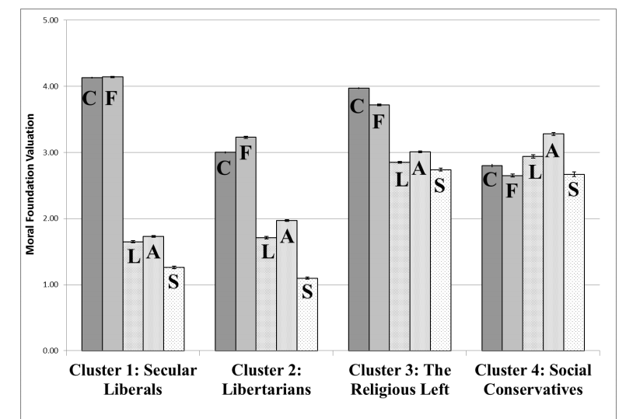
Cluster analysis of Moral Foundations Questionnaire responses
C=Care, F=Fairness, L=Loyalty, A=Authority, S=Sanctity
Graham, Haidt et al (2012) Moral Foundations Theory

Slide 40
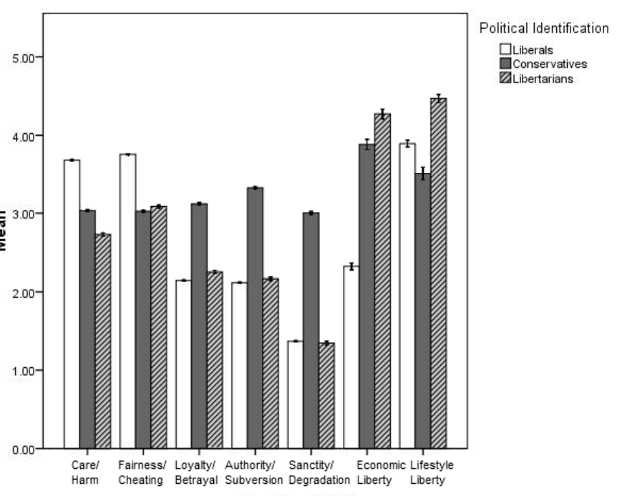
Moral concerns of libertarians as compared to liberals and conservatives

Slide 41
Constructing a Theory of Change
Is there a distinctively spiritual process of change that fosters compassion & accountability,
Helping care seekers intentionally reconstruct and practice life-giving values, beliefs and ways coping?

Slide 42
Theory of Spiritually-Integrated Change
DISTINCTIVELY SPIRITUAL EXPERIENCE OF COMPASSION
CHANGE PROCESS
COMPASSION
OUTCOMES:
PSYCHOLOGICAL
LIFE-GIVING SPIRITUAL PRACTICES AND THEOLOGICAL PERSPECTIVES ON SUFFERING
RELATIONAL
COMMUNAL
THEOLOGICAL & SPIRITUAL INTEGRATION
Notes:
There are distinctively spiritual practices that begin a change process.
The change process is inherently spiritual and theological.
Change happens when compassion is experienced, which in turn shifts theological perspectives on suffering.
Change involves a spiritual and theological integration, which has psychological, relational, and communal outcomes.

Slide 43

Ripple Effects of Change
Creation
Community and Social Systems
Significant Relationships
Embodied Self
Process Relational God of Becoming

