Slide 1
IST 3034 PTSD Course
Carrie Doehring, Professor of Pastoral Care
Iliff School of Theology
cdoehring@Iliff.edu
January 8, 2017

Slide 2
Paradigms of Pastoral Care: HISTORICAL
WHY: To save souls (salvation) through faith in God/Jesus Christ
WHO: By ordained priests/ministers; endorsed chaplains
HOW: Directing/guiding people to belief (teaching adherence)
Reconciling people to God/Jesus (through ritual/discipline)
Healing souls (care of souls)
WHAT: Ministry of guidance/witness that guides through witness to bible (the textual/excusive source of authority/truth)
Ministry of presence that heals/reconciles through personal relationship with God/ Jesus

Slide 3
Paradigms of Pastoral/Spiritual Care: THERAPEUTIC
WHY: Holistic healing of body & soul
WHO: Ordained/endorsed chaplains/pastoral counselors
HOW: Holistic healing through intensive one-on-one therapeutic relationships that psychodynamically explore emotional issues & traumatic memories
WHAT: Ministry of therapeutic presence that heals/reconciles through personal relationship with chaplain or counselor or supervisor that incarnates presence of God/ Jesus

Slide 4
Paradigms of Spiritual Care: INTERCULTURAL
WHY: Liberative spiritual integration of persons/communities/world
WHO: Theologically educated & professionally qualified/licensed
HOW: Intercultural presence that builds trust by respecting religious, spiritual, and cultural differences
WHAT: Ministry of intercultural presence that uses spiritual practices to increase compassionate awareness of embodied life-limiting cultural meanings of suffering in order to co-create contextual intentional beliefs, values, and practices that foster liberative goodness.

Slide 5
Paradigms of Spiritual Care: EVIDENCE-BASED
WHY: Spiritual integration, physical and behavioral health, patient satisfaction and shortened hospital stays
WHO: Healthcare professionals with clinical pastoral education;
HOW: Uses evidenced based assessments and interventions proven to promote positive spiritual coping, reduce chronic spiritual struggles, and shorten hospital stays
WHAT: Spirituality is a search for the sacred and “. . . the journey people take to discover and realize their essential selves and higher order aspirations” (Pargament, 2007, p. 58). Religions offer organizational contexts for pursing this search for the sacred, providing historical and contemporary systems of beliefs, values, symbols, sacred texts, and practices like personal and communal worship.

Slide 6
HOW does pastoral/spiritual care help?
1. PRESENCE: Respect & trust helps people find spiritual practices that
foster embodied experiences of goodness &
self-compassion
HOSPITAL stay & satisfaction
HEALTH: Physical, Behavioral
SPIRITUAL Integration
EVIDENCE-BASED OUTCOMES
2. LIFE-GIVING MEANINGS (Intentional theologies/orienting systems) integrate compassion/care, counteracting life-limiting embedded oppressive fear- & shame-based theologies/ orienting systems
Notes:
There are distinctively spiritual practices that begin a change process.
The change process is inherently spiritual and theological.
Change happens when compassion is experienced, which in turn shifts theological perspectives on suffering.
Change involves a spiritual and theological integration, which has psychological, relational, and communal outcomes.

Slide 7
Intercultural & Evidence-based Spiritual Care
Values of Caring/Preventing Harm are cornerstone values that generate complex theologies of caring that respect theological/ideological/political differences exaggerated by values like loyalty/betrayal, authority/subversion, liberty/oppression (see www.moralfoundations.org)
Values of Caring/Preventing Harm bring clarity to issues of conscience that generate spiritual struggles that exacerbate PTS
• Intercultural spiritual care interfaces with evidence-based behavioral health, especially to understand and respond to religious and spiritual struggles and moral injury (see the research of Ken Pargament)

Slide 8
Spiritual Care: More than Ministry of Presence
Ministry of Presence: when spiritual care practitioners do their own work of spiritual integration they can be a compassionate presence, prompting them to use practices fostering self compassion.
On its own, a ministry of presence “is a minimalist, almost ephemeral, form of empathic spiritual care that is, at the same time deeply rooted in religious histories…It is religion stripped to the basics. Religion naturalized. Religion without code, cult, or community, Religion without metaphysics. It is religion for a state of uncertainty. As is typical of American religion, it both resists specific theological elaboration and is deeply rooted in a specifically Christian theology of incarnation” (Sullivan, 2014, p. 174)

Slide 9
Presence + Co-creating Meaning
Ministry of Presence: when chaplains/spiritual care practitioners do their own work of spiritual integration they can be that compassionate presence, prompting people to use spiritual practices fostering self compassion, goodness and love.
Co-creating meanings, especially about suffering: Experiencing goodness reveals the life-limiting embedded orienting systems shaped by intersecting social oppressions, prompting people experiencing PTS to co-create complex intentional meanings about suffering, which generate flexible coping and spiritual integration

Slide 10
Intercultural Co-Creation of Meanings
Chaplains/spiritual care practitioners need to be literate in religions of the world, especially their spiritual and religious practices and ways of understanding suffering
Chaplains/spiritual care practitioners need to be theologically reflexive about how they themselves spiritually integrate personal suffering
Chaplains/spiritual care practitioners need to respectfully step into the existential/religious worlds of those experiencing PTS and deeply respect whatever is sacred for them
Once trust is established, chaplains/spiritual care practitioners need to follow the other’s lead in co-creating meanings (if appropriate) and/or referring to those in that person’s tradition

Slide 11
Religious & Spiritual Struggles & Moral Stress
Being a good
son or daughter,
partner,
parent
Religious struggles, Moral stress
Doing a good job
SHAME
GUILT
FEAR
Notes:
We experience inevitable tensions of having multiple commitments, each involving core values:
Being a good parent / Doing a good job / Self-care
Core values conflicts undermine integrity when they give rise to shame and guilt and Fear about causing harm by putting ultimate commitments in jeopardy

Slide 12
Shame/Guilt/Fear Narrow Our Horizons
Notes:
Shame guilt and fear narrow our horizons and everything can take on a life or death quality

Slide 13
Notes:
Spiritual practices that foster self-compassion widen our horizons.

Slide 14
Religious & Spiritual Struggles & Moral Stress
INJURY:
PTSD where fear of death sets off intense neurophysiological traumatic response, resulting in atute stress response that over times develops into all symptoms of PTSD
MORAL INJURY where someone else is actually harmed in irrevocable ways, and the ‘perpetrator’ is haunted by shame guilt
Religious struggles, Moral stress
Doing a good job
Being a good
son or daughter,
partner,
parent
SHAME
GUILT
FEAR
ANGER
Notes:
We experience inevitable tensions of having multiple commitments, each involving core values:
Being a good parent / Doing a good job / Self-care
Core values conflicts undermine integrity when they give rise to shame and guilt and Fear about causing harm by putting ultimate commitments in jeopardy

Slide 15
Spiritual Care prevents PTSD and Moral Injury
Religious struggles, Moral stress are integrated through spiritual care
Doing a good job
Being a good
son or daughter,
partner,
parent
Prevents
INJURY:
PTSD & MORAL INJURY
SPIRITUAL PRACTICES fostering compassion embraces shame, guilt, fear, anger; COMPLEX MEANINGS are co-created
Notes:
We experience inevitable tensions of having multiple commitments, each involving core values:
Being a good parent / Doing a good job / Self-care
Core values conflicts undermine integrity when they give rise to shame and guilt and Fear about causing harm by putting ultimate commitments in jeopardy

Slide 16
Compassion-based practices
COUNTERACTS FEAR
EXPORES ANGER
COMPASSION
UNCOVERS SHAME
FOSTERS ACCOUNTABILITY

Slide 17
Doing A Life Values Inventory
High priority values
Over-attention to values that are not truly high priority
Under-attention to values that ought to be higher priority
Low priority values
© The Iliff School of Theology, 2015
Notes:
TWENTY MINUTES:
Fifteen minutes of self reflection: go over the brief list of values, give them 10 - 15”
Five minutes of plenary discussion about what that was like

Slide 18
Types of spiritually oriented care
Short-term Pastoral/ Spiritual Care: Community of Faith or Chaplaincy | Spiritual Direction (Long-term) | Behavioral Health Counseling/ Therapy

Slide 19
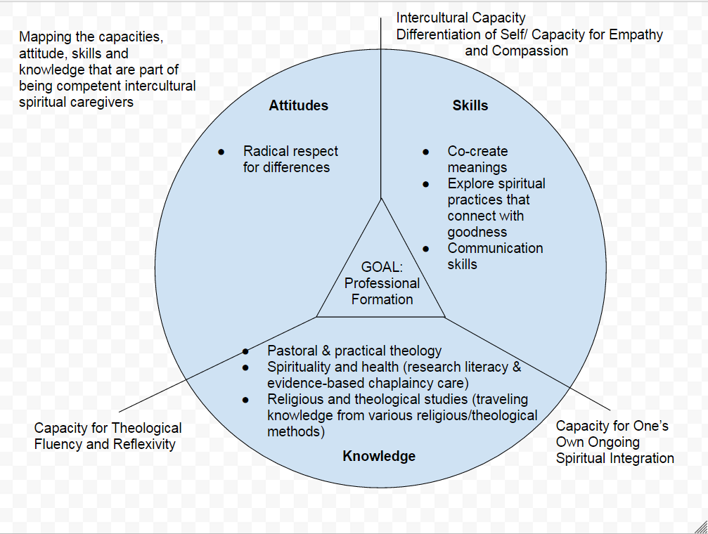
Intercultural Competency

Slide 20
1. An Intercultural Capacity & Differentiation of Self
Understanding and responding to the unique contextual ways people live out values, beliefs, and ways of coping/connecting to the sacred (their relational spirituality and orienting systems).
Moving from being Ethnocentrically oriented by defending one’s culture and/or minimizing cultural differences to
Ethnorelative orientations of (1) accepting one’s own worldviews as one among many valid worldviews, (2) being respectful guests entering into another’s worldview, and (3) adjusting one’s behaviors in ways that communicate respect and intercultural empathy.

Slide 21
1. An Intercultural Capacity & Differentiation of Self
Identifying stress/emotional reactions in the midst of care conversations
Discerning whether these reactions arise from
-within themselves (and their ‘lived theologies/orienting systems’)
-between them and the care seeker
-from intersecting aspects of either their or the care seeker’s social identities (i.e. implicit biases about race, gender, orientation).
Differentiation of self is needed for theological empathy: stepping into another’s spiritual orientation and respecting unique values, beliefs, ways of coping and connecting and with sacred.

Slide 22
2. Theological Fluency & Reflexivity
Theological literacy: knowing about various theological perspectives, methods, or second-order ways of reflecting upon religious and spiritual experiences (e.g., comparative studies of religions, biblical studies, historical studies, theological and ethical studies and practical theological studies).
Theological fluency: being able to use these perspectives in a fluid and embodied way in the practice of pastoral and spiritual care (Doehring, 2002).

Slide 23
2. Theological Fluency & Reflexivity
Self-reflexivity: the process of reflecting upon one’s own story from multiple diverging standpoints take into account one’s privilege and disadvantage within intersecting social systems like sexism, racism, and heterosexism.
Theological reflexivity: (1) Tracking one’s personal theology/orienting system (stress-related and intentional beliefs, values and practices for coping) and discerning how it shapes a care-giving relationship.
(2) Using one’s theological education to assess whether one’s personal theologies are life-giving or life-limiting in particular contexts of care.
(3) Being accountable for drawing upon one’s theological education to assess the care seeker’s embedded and espoused beliefs, values, and practices.
(4) Drawing upon personal as well as public theologies to collaborate with care seekers in co-constructing life-giving contextual beliefs and values that can be tested in practice.

Slide 24
3. Spiritual Integration
Using spiritual practices (communal/personal) to experience love or goodness or benevolence from God (in theistic traditions) and others, especially in one’s bodies
Experiencing goodness reveals the life-limiting embedded orienting systems shaped by intersecting social oppressions, and helps people co-create complex intentional meanings about suffering
Experiencing goodness and complex meanings make people use more flexible coping that counteracts consumerism
Integrating spiritual practices and intentional meanings into daily life has liberative ripple effects
*Pargament, Desai & McConnell, 2006; Doehring, 2015a, Doehring, 2015b

Slide 25
Attitude: “The implicit and explicit perspectives and/or biases people hold about spirituality and religion and how they relate to the practice of [spiritual care]” (Vieten et al, 2013, p. 4). Radical Respect for Religious Differences
Respect irreducible differences without searching for “one God”
Focus on lived practices, values, and beliefs
Dialogue with full awareness of biases & “intractable otherness”
Moyaert, M. (2012). Recent developments in the theology of interreligious dialogue: From soteriological openness to hermeneutical openness. Modern Theology, 28(1), 25-52.

Slide 26
Knowledge
“Information, facts, concepts, and awareness of research literature [spiritual caregivers] should possess about spirituality and religion as it relates to the practice of [spiritual care]” (Vieten et al, 2013, p. 4).
Pastoral & practical theology
Spirituality and health (research literacy & evidence-based chaplaincy care)
Religious and theological studies (traveling knowledge from various religious/theological methods)

Slide 27
Skills
Explore spiritual practices that connect with goodness
Co-create meanings
Communication skills using motivational interviewing to help people explore the value of change (why change) and tools for change (how to change)

Slide 28
References
Clebsch, W. A., & Jaekle, C. R. (1964). Pastoral care in historical perspective. Englewood Cliffs, NJ: Prentice-Hall.
Doehring, C. (2002). Theological literacy and fluency in a new millennium: A pastoral theological perspective. In R. L. Petersen & N. M. Rourke (Eds.), Theological literacy for the twenty-first century (pp. 311-324). Grand Rapids, MI: Eerdmans Press.
Doehring, C. (2015a). The practice of pastoral care: A postmodern approach (Rev. & Expanded). Louisville, KY: Westminster John Knox.
Doehring, C. (2015b). Resilience as the relational ability to spiritually integrate moral stress. Pastoral Psychology, 64(5), 635-649. doi: 10.1007/s11089-015-0643-7
Exline, J. J., Pargament, K., Grubbs, J. B., & Yali, A. M. (2014). The Religious and Spiritual Struggles Scale: Development and initial validation. Psychology of Religion and Spirituality, 6(3), 208-222. doi: 10.1037/a0036465.sup
Graham, L. (2014). Lecture on war: Theology and religious practice. Denver, CO.
Haidt, J. (2003). The moral emotions. In R. J. Davidson, K. R. Scherer & H. H. Goldsmith (Eds.), Handbook of affective sciences. (pp. 852-870). New York, NY: Oxford University Press.
Hammer, M. R., Bennett, M. J., & Wiseman, R. (2003). Measuring intercultural sensitivity: The intercultural development inventory. International Journal of Intercultural Relations, 27(4), 421-443. doi: http://dx.doi.org/10.1016/S0147-1767(03)00032-4
Handzo, G. F., Cobb, M., Holmes, C., Kelly, E., & Sinclair, S. (2014). Outcomes for professional health care chaplaincy: An international call to action. Journal of Health Care Chaplaincy, 20(2), 43-53. doi: 10.1080/08854726.2014.902713
Moyaert, M. (2012). Recent developments in the theology of interreligious dialogue: From soteriological openness to hermeneutical openness. Modern Theology, 28(1), 25-52.

Slide 29
References
Myers-Shirk, S. (2009). Helping the good shepherd: Pastoral counselors in a psychotherapeutic culture 1925-1975. Baltimore, MD: The Johns Hopkins University Press.
Pargament, K., Desai, K. M., & McConnell, K. M. (2006). Spirituality: A pathway to posttraumatic growth or decline? In L. G. Calhoun & R. G. Tedeschi (Eds.), Handbook of posttraumatic growth: Research and practice (pp. 121-135). Mahwah, NJ: Erlbaum.
Pargament, K. (2007). Spiritually integrated psychotherapy: Understanding and addressing the sacred. New York, NY: Guilford Press.
Pargament, K., Mahoney, A., Exline, J., Jones Jr., J., & Shafranske, E. (2013). Envisioning an integrative paradigm for the psychology of religion and spirituality: An introduction to the APA handbook of psychology, religion and spirituality In K. Pargament, A. Mahoney, J. Exline, J. Jones Jr. & E. Shafranske (Eds.), APA handbook of psychology, religion and spirituality (Vol. 1, pp. 3-19). Washington, DC: American Psychological Association.
Patton, J. (1993). Pastoral care in context: An introduction to pastoral care. Louisville, KY: Westminster John Knox Press.
Sullivan, W. F. (2014). A ministry of presence: Chaplaincy, spiritual care, and the law. University of Chicago Press: Chicago, IL.
Waggoner, E. (2014). Pathways to military chaplaincy: An invitation to theologically centrist and left-of-center seminaries, schools of theology, and divinity schools. Fort Worth, TX: The Forum on Military Chaplaincy.
Vieten, C., Scammell, S., Pilato, R., Ammondson, I., Pargament, K., & Lukoff, D. (2013). Spiritual and religious competencies for psychologists. Psychology of Religion and Spirituality, 5(3), 129-144. doi: 10.1037/a0032699.supp

