Slide 1
Sallie Mcfague ecofeminist theologian
By Amy Lythgoe, Constructive Theology Spring 2017

Slide 2
. Basic biography
1933 -
Born in Quincy, Massachusetts
American Feminist Theologian

Slide 3
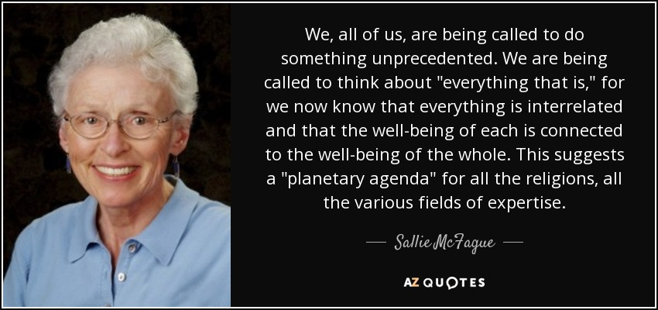
Must speak of God through metaphor
Her particular orientation is via ecological issues and the concept of caring for the earth as though it is God’s “body”

Slide 4
education
B.A., English Literature, Smith College (1955)
B.Div., Yale Divinity School (1959)
M.A., Yale (1960)
Ph.D., Yale (1964)
Doctoral thesis: Literature and the Christian Life
Litt.D., Smith College (1977)
Notes:
Compiled from online copy of Sallie McFague’s CV http://vst.edu/wp-content/uploads/2014/08/CV_McFague_Fall_2009.pdf (accessed May 1, 2017).

Slide 5
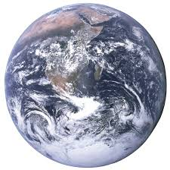
influencers
Karl Barth
Dialectical theology
Gordon Kaufman
God as Mystery
“Real referent”
“Transcendent unknown”
H. Richard Niebuhr
Experience, relativity, imagination, and the role of affections
Yale Professor

Slide 6
influencers
Ecotheology
Pierre Teilhard de Chardin (synthesis of Christian theology and evolutionary biology)
Process Theologians
Ian Barbour & John Haught
Philosophy
Alfred North Whitehead

Slide 7
influencers
Jürgen Moltmann
Green thinking with theology
Christology in which Christ suffers along with the earth and the possibility of redemptive purpose in this realm
Environmental Theology
Idealized philosophy of stable interrelationships more than the scientific study of the environment
Anglican Church of Canada

Slide 8
Teaching Career
Carpenter Professor of Theology, Vanderbilt University Divinity School, Nashville, Tennessee (1980-2000)
Distinguished Theologian in Residence, Vancouver School of Theology, British Columbia, Canada (2000-present)
Notes:
Compiled from online copy of Sallie McFague’s CV http://vst.edu/wp-content/uploads/2014/08/CV_McFague_Fall_2009.pdf (accessed May 1, 2017).

Slide 9
Selected Bibliography
Speaking in Parables: A Study in Metaphor and Theology. Philadelphia: Fortress Press (1975)
Metaphorical Theology: Models of God in Religious Language. Philadelphia: Fortress Press (1982)
Models of God: Theology for an Ecological, Nuclear Age. Philadelphia: Fortress Press (1987)
The Body of God: An Ecological Theology. Minneapolis: Fortress Press (1987)
Super, Natural Christians: How we should love nature. London: SCM (1997)
Life Abundant: Rethinking Theology and Economy for a Planet in Peril (Searching for a New Framework). Minneapolis: Augsburg Fortress (2000)
A New Climate for Theology: God, the World and Global Warming. Minneapolis: Augsburg Fortress (2008)

Slide 10
RELATIONSHIP BETWEEN THEOLOGY &
BIOLOGICAL SCIENCES (1970s+)
Growing awareness of how increasing human population and industrialization contribute to environmental damage
All creation’s survival (not just human) is threatened
Attempt to envision how God can be seen operating in the natural world, within and among creation

Slide 11
Evolution & theology
2nd idea became more influential in 20th Century and beyond
Flows into theological, social, political & ethical issues
Examples: genetic mutations, cloning, manipulation & programming
1. God started the process of evolution and then left nature to itself
2. God is intricately involved in process of creation, suffering in and with the natural world

Slide 12
Also to consider
How does applying genetics to the non-human sphere of creation impact creation as a whole?
The need to focus on social, ethical, political and practical issues even more than the scientific ones
Environmental issues in general, and ecology in particular
Models of cooperation
Includes integration and symbiosis as inspiration for human behavior

Slide 13
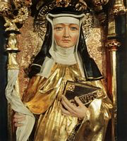
Feminist theology
Unfolding Influences
Women’s increased access to employment, higher education, leadership & ordained ministry (Europe and North America)
Women granted access to theological Academy
African, Asian & Latin American women contribute to postcolonial, liberation & inculturated theological conversations
All point to inherent patriarchy & colonial structures still present and the relationship between colonialism and sexism
Notes:
Image of Hildegard of Bingen via Google Images (accessed May 1, 2017).

Slide 14
Impacts
Global conversation
Issues and questions of common concern
Provides diverse social and cultural context for theological frameworks and construction
Includes liberation from colonial oppression: unjust global trade, solidarity with poor, giving voice to world’s marginalized and othered
Notes:
“Feminist Theology” image via Google Images (accessed May 1, 2017).

Slide 15
considerations
Raised consciousness around political and ethical impacts of what is said, who says it, and how it is said
Recognition that no one speaks to anything without coming from a particular social construction and context
We must be mindful of how our social location impacts our understandings and further theological wrestling
Multiple voices and perspectives add to the richness of theological consideration by offering the reality of human differences

Slide 16
Feminist theology’s Particular Area of concern
~ The “Male God” ~
Idolizing a male God supports patriarchy and other forms of oppression
McFague’s root metaphor of “fatherhood” for God as a way to consider the material and cultural subjugation of women and the larger problems Christian theology has historically refused to consider
God’s nature cannot be confined to or considered from any particular name or image
God is larger than any particular way we can construct

Slide 17
Concerns about Feminist theology
Rooted in the experiences of white, middle-class, North American or European heterosexual women
Attempted overlay to all women’s experiences calls for the need to deconstruct even the idea of “woman” as a mainstream, patriarchal term and outside the mainstream patriarchal church construct

Slide 18
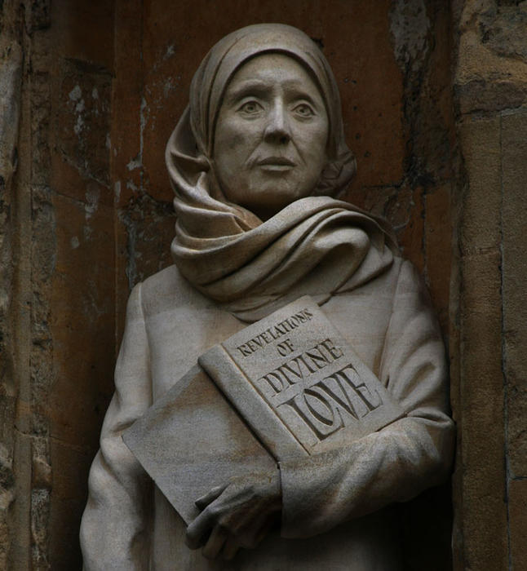
ecofeminist theology
Branch of Feminist Theology
Link between oppressing the earth and oppressing women
Urges new scientific focus on care for, rather than control of, creation
Most intense viewpoint: humans as earthly parasite rather than at top of creational hierarchy
Notes:
Image of Blessed Julian of Norwich via Google Images (accessed May 1, 2017).

Slide 19
Prominent ecofeminists
Sallie McFague, Carolyn Merchant & Rosemary Radford Ruether (U.S.A.)
Merchant: We need to approach the natural world relationally
Reuther: Uses images of Gaia as the divine within nature complementing the God of Law and Covenant
Anne Primavesi, Ruth Page, Mary Grey (U.K.)
Primavesi: The earth functions as a single organism
Page: God’s immanence is expressed with creation rather than in creation (when considering matters of suffering in evolution)
Grey: Focus on reconciliation and redemption with creation

Slide 20
McFAgue’s contributions
Replacing all male God language and metaphor is not helpful
Instead, we must add to the language and metaphor, using multicultural, layered constructs that meet all people
Need to recognize that metaphors have cultural implications that reflect underlying attitudes
Social understandings and constructs
Example: God as Mother—people have different meanings for “mother” in mind, “mother” roles and expectations are relative, “femininity” is subjective

Slide 21
Eco-theology: philosophical & theological tensions
Anthopocentrism: stresses the value on humans—human characteristics define worth; personhood is beyond comparison to other non-human forms of life (individualism)
Biocentrism: stresses the value on all biological species—biological characteristics define worth (holism)
Notes:
Eco-theology image via Google Images (accessed May 1, 2017).

Slide 22
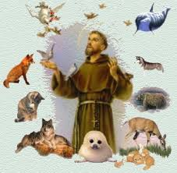
impacts
Using animals in biological research
Importance of protecting endangered species or human progress
Humans’ level of responsibility for serving as caretakers or authority over rest of creation
These considerations lead to or away from animal rights’ movement and environmental activism
Notes:
Saint Francis image via Google Images (accessed May 1, 2017).

Slide 23
Final wonderings
Christian Anthropology
“What does it mean to be human in a biological world where human genetic make up amounts to 98 percent of that of primates?”
What do the Genesis accounts tell us about humanity’s place in and among the rest of God’s creation?
How do we live and move and have our being with God and God with us?
Notes:
Eco-theology image via Google Images (accessed May 1, 2017).

Slide 24
Works cited
*AZ Quotes. “Sallie McFague.” Accessed May 1, 2017. http://www.azquotes.com/author/52832-Sallie_McFague.
*Christian Feminism Today. “Christian Ecofeminist Theology Today or Gaia, Sallie McFague, and You Walk into a Bar…” Accessed May 1, 2017. https://eewc.com/christian-ecofeminist-theology/.
*Jesus Jazz and Buddhism. “When Christians Convert to the Earth: Pope Francis, Sallie McFague, and Process Theology.” Accessed May 1, 2017. http://www.jesusjazzbuddhism.org/when-christians-convert-to-the-earth-pope-francis-sallie-mcfague-and-process-theology.html.

Slide 25
Works cited
*Johnson, Elizabeth A. She Who Is: the Mystery of God in Feminist Theological Discourse. 10th ed. New York: The Crossroad Publishing Company, 2002.
*McFague, Sallie. Models of God: Theology for an Ecological, Nuclear Age. Philadelphia: Fortress Press, 1987.
*The Modern Theologians: An Introduction to Christian Theology Since 1918. 3rd ed. The Great Theologians. Malden, MA: Blackwell Pub., 2005.
*Practical Compassion. “In the Words of Pierre Teilhard de Chardin.” Accessed May 1, 2017. http://dena-patrick.blogspot.com/2014/07/in-words-of-pierre-teilhard-de-chardin.html.

Slide 26
Works cited
*Shuck and Jive. “Climate Change Demands We Live Differently.” Accessed May 1, 2017.
http://www.shuckandjive.xyz/2009/12/climate-change-demands-we-live.html.
*Wikipedia. “Carolyn Merchant.” Accessed May 1, 2017. https://en.wikipedia.org/wiki/Carolyn_Merchant.
*Wikipedia. “Gordon D. Kaufman.” Accessed May 1, 2017. https://en.wikipedia.org/wiki/Gordon_D._Kaufman.
*Wikipedia. “Sallie McFague.” Accessed May 1, 2017 https://en.wikipedia.org/wiki/Sallie_McFague.

