Slide 1
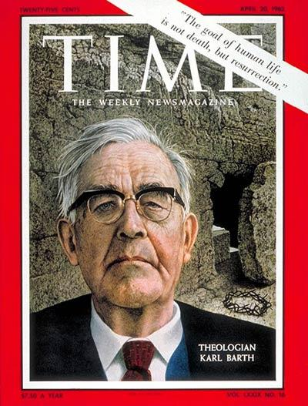
Karl Barth
Commonly referred to as the greatest, or most influential Protestant theologian of the 20th century
Compiled by Toni Chance

Slide 2
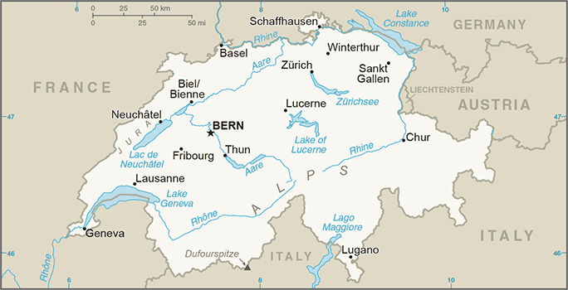
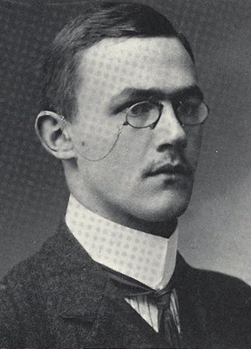
Biographical Information
Born 10 May 1886 in Basel, Switzerland
Raised in a Reformed/Liberal Protestant family
Family focus on religious work:
Father was a Reformed minister & professor of New Testament & church history
Maternal grandfather was a conservative Reformed pastor.
Family moved to Bern when Karl was young, so he mostly grew up there.
Married Nelly Hoffman, with whom he had 4 sons & 1 daughter
Died 10 December 1968 in Basel
Cross, p. 163; Feenstra, p. 52; Torrance, p. 2-3; Webster, pp. 2-6; Zellwegger.

Slide 3
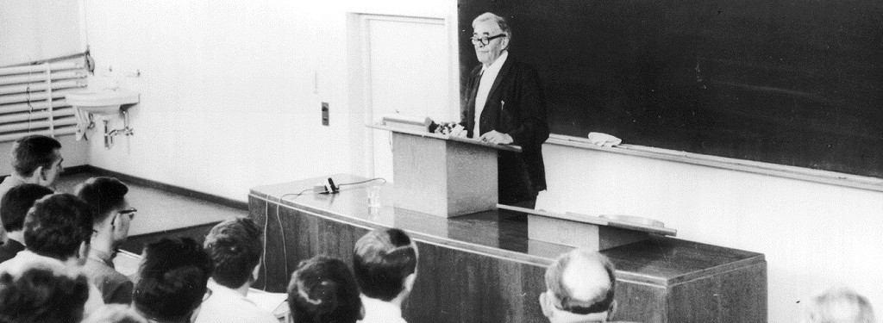
Education & Work
Studied theology at the Universities of Bern, Berlin, Tübingen, & Marburg
Ordained in the Reformed Church in 1908
Served as a pastor in Geneva (1909-11) & Safenwil, Switzerland (1911-21)
Appointed Honorary Professor of Reformed Theology at the University of Göttingen (despite not having a doctoral degree) due to his prominence among his German contemporaries
Taught at Universities of Göttingen (1921-25), Münster (1925-30), Bonn (1930-34), & Basel (1935-62)
Cross, p. 163; Feenstra, p. 52; Webster, pp. 2-6.

Slide 4
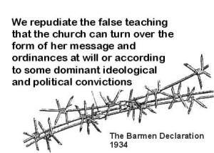
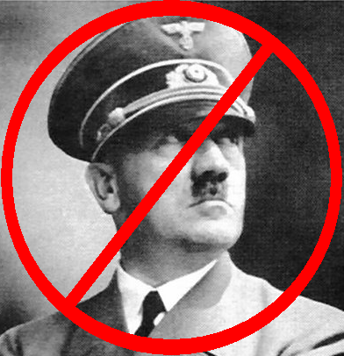
Political Perspectives
Opposed the 93 German intellectuals (including many of his own university professors) who signed a manifesto supporting Kaiser Wilhelm II & his war policy at the outset of WWI & referred to this as an “ethical failure” reflecting the erroneous nature of Protestant liberal theology
Refused to comply with the Nazi regime’s mandate to begin all lectures with the Hitler salute & continued to begin lecture with prayer
Largely responsible for writing the Barmen Declaration, an anti-Nazi confession of faith, which he mailed to Hitler personally
Suspended from his teaching position in 1934 when he refused to take an obligatory oath of allegiance to Hitler & returned to Switzerland to teach after his appeal was denied
Voluntarily served in the Swiss auxiliary army as a soldier to protect neutral Switzerland during WWII
Criticized for not openly opposing communism after WWII but responded that “the church should not take sides in the Cold War, but should find a ‘third way’ between communism & anticommunism.” (Feenstra, p. 52)
Cross, p. 163; Feenstra, p. 52, 54; Webster, pp. 2-6; Zellwegger.

Slide 5
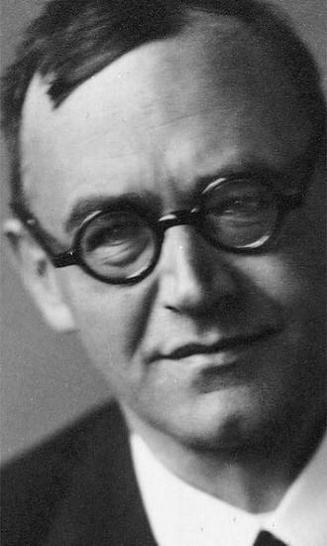
Change in Theoretical Approach
Serving as a pastor led Barth to begin questioning mainstream Protestant theological liberalism, which he found lacking in informing his work as a pastor & preacher, which required a dual focus on biblical teachings & daily concerns of his parishioners.
Unease with the state of protestant theology resulted in a heavy emphasis on reconstructing his own theological understanding, which manifested in intense biblical study, writing, & providing lectures toward the end of his time as a pastor.
Barth’s primary concern was that liberal Protestantism was overly focused on humanity & human concerns rather than the deity of God.
Feenstra, p. 52; Torrance, 3-6, 84-85; Webster, pp. 2-6; Zellwegger.

Slide 6
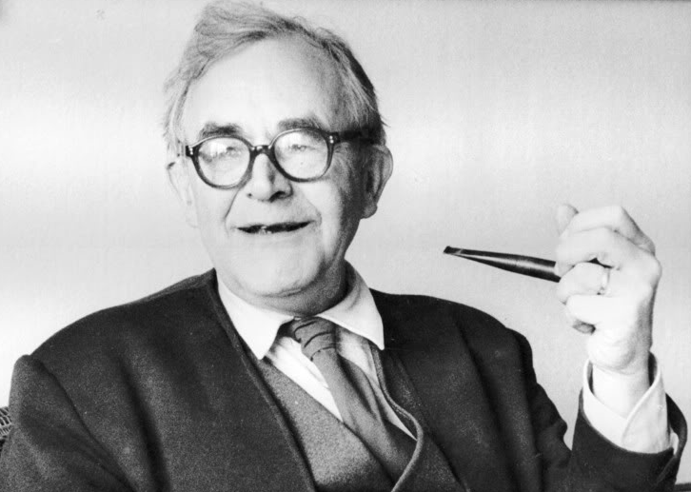
Theological Descriptions of Barth’s Work
Dialectical Theology
There is a fundamental contradiction (or dialectic) between God & humanity.
Infinite God cannot be known by finite humans.
Neo-Orthodoxy
Renewed focus on 17th century Reformed orthodoxy
God is transcendent & ‘other’
Theology of the Word of God
Centers Christian theology on scriptural revelation
Theological response to the intrinsic nature of God’s Word rather than human concerns
Humans can only speak of God’s Word, not of God.
Popular in America during the 1930s
Dialectical theology is AKA theology of crisis.
Feenstra, p. 53; McGrath, pp. 73-74; Torrance, 11, 83-100.

Slide 7
Barth in Conversation with Other Theologians
Barth defined is relationship with other theologians as follows…
In agreement with:
In opposition to:
Martin Luther
John Calvin
Søren Kierkegaard
Friedrich Schleiermacher
Albrecht Ritschl
Adolf von Harnack
Ernst Troeltsch
Emil Brunner
Georg Hegel
Cross, p. 163; Feenstra, p. 52

Slide 8
Major Theological Themes
Barth has had wide influence on many areas of theology, but perhaps most critically on divine revelation.
The subject of theology is God rather than humans.
Theology must flow from God above to humans below.
God is fundamentally & qualitatively different than humans & cannot be known by humans in the way other things can be known.
God’s self-revelation conceals more than it reveals.
Humans must search scripture for God’s revelation.
Revelation is a relational experience between God & humans that spans the infinite difference between.
“Jesus Christ is God of God, God with us as we are in this world of space & time, & that in Jesus God himself is personally at work, vicariously & redemptively, in the ontological depths of our alienated humanity, renewing the creation & fulfilling his eternal purpose of love for the restoration & communion of mankind with himself” (Torrance, p. 161).
Feenstra, p. 53; McGrath, pp. 68; Torrance, p. 16-17; 90, 161; Webster, pp. 2-6.

Slide 9
View of Religion
Religion, defined as “an upward search for God on the part of humanity” is a human construction, “an act of defiance in the face of God.”
“There is a radical discontinuity between God’s self-revelation to humanity, which leads to faith, and humanity’s search for God, which leads to religion.”
(McGrath, p. 414)

Slide 10
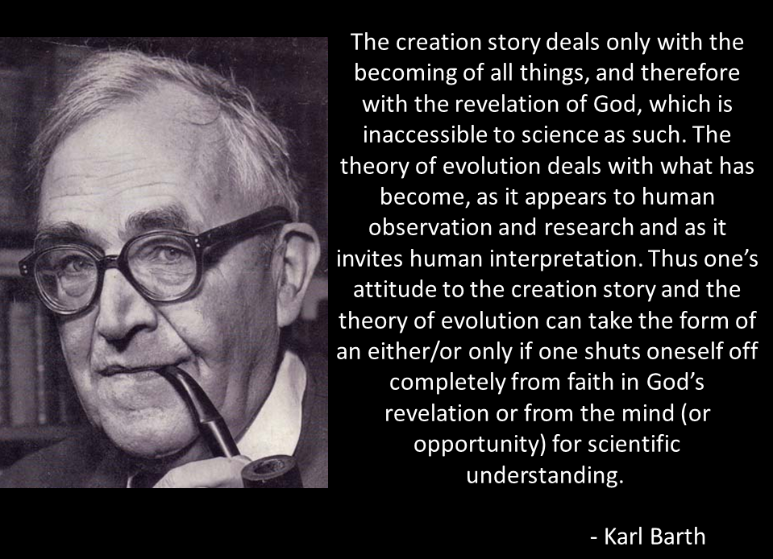
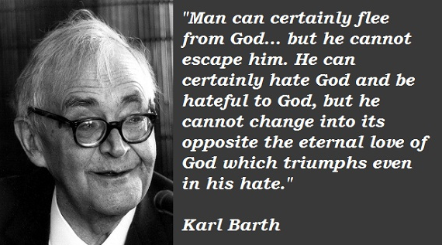
Barth Quotes

Slide 11
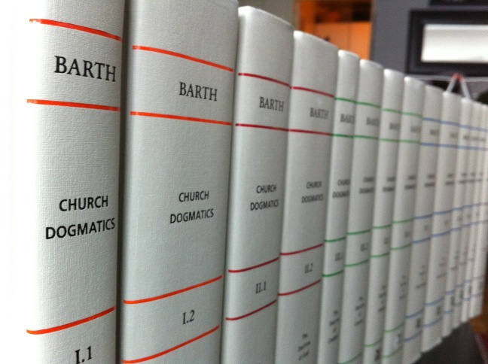
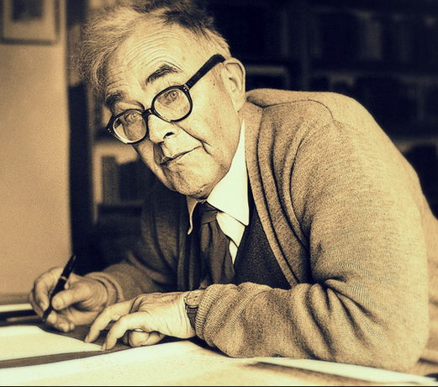
Major Works
Barth wrote more than 600 publications over his lifetime, significantly including:
The Epistle to the Romans
Barmen Declaration
Church Dogmatics
Barth’s final multi-volume work, Church Dogmatics was incomplete at the time of his death but outlined his theological perspectives on revelation, God, creation, & atonement.
Church Dogmatics is often described as one of the most significant works of theology in the 20th century.
Zellwegger

Slide 12
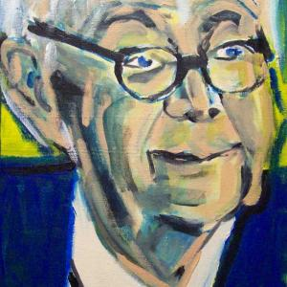
Barth’s Continuing Place in Contemporary Theology
Karl Barth remains an important voice in current theological development because of his role in developing the idea of dialectical theology & his broad & significant influence in re-imagining the theology of liberal theologians, such as Schleiermacher.
Barth’s theology continues to have an impact in the traditional conservative understanding of God, the divine-human relationship, & the role of revelation through biblical scripture.
Whether one agrees with Barth or not, his importance must be recognized & acknowledged in the history of theological thought & development.
We can also look to Barth’s courage to stand up for his own convictions in strong opposition to Hitler’s Nazi regime.

Slide 13
Works Cited
Cross, F. L., & Livingstone, E. A. (Eds.). (2005). In The Oxford Dictionary of the Christian Church (3rd ed. rev., pp. 163–164). Oxford; New York: Oxford University Press.
Feenstra, Ronald J. (2002). “Karl Barth,” in Biographical Dictionary of Christian Theologians (Eds. Patrick W. Carey and Joseph T. Lienhard). Peabody, MA: Hendrickson Publishers, pp. 52-56.
McGrath, Alister E. (2017). Christian Theology: An Introduction. Chicester, West Sussex, UK: Wiley Blackwell.
Torrance, Thomas F. (1990). Karl Barth, Biblical and Evangelical Theologian. Edinburgh, Scotland: T&T Clark.
Webster, John. (2000). Barth. London: Continuum.
Zellwegger, Barbara. (n.d.) Karl Barth: Biography. The Center for Barth Studies at Princeton Theological Seminary. Retrieved from http://barth.ptsem.edu/karl-barth/biography

