Slide 1
IST 2012 Pastoral Theology and Care
Fall, 2021

Slide 2
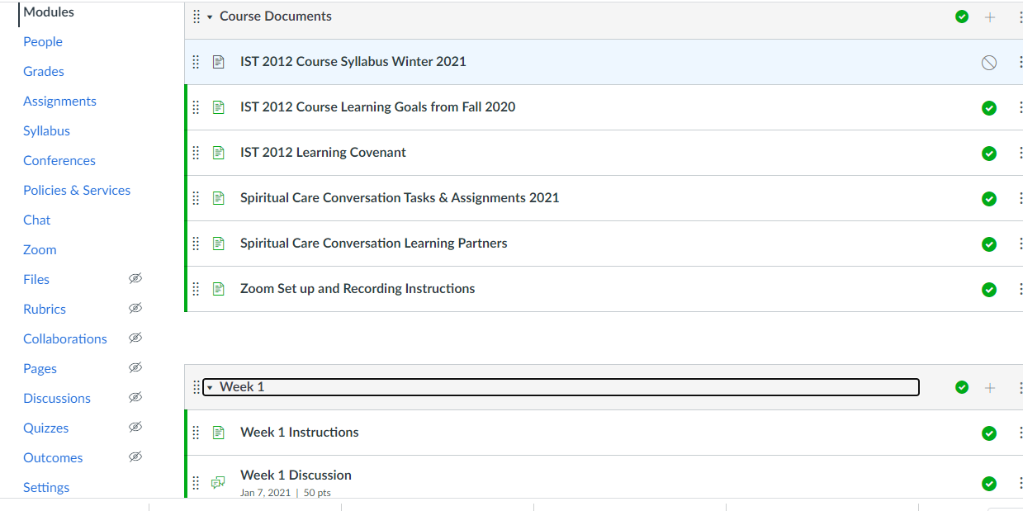
There is a module for each week in our ten-week quarter. Each module lists instructions and assignments for that week

Slide 3
Tech Questions Content Questions support@iliff.edu cdoehring@iliff.edu

Slide 4



Required Textbook:
Make sure you have the 2015 edition
NO! 2005 edition
YES: 2015

Slide 5
Cite Sources in APA format
(Author_last_name, year, p. x)
(Doehring, 2015, p. 32)
(Doehring, 2015, pp. 1-2)

Slide 6
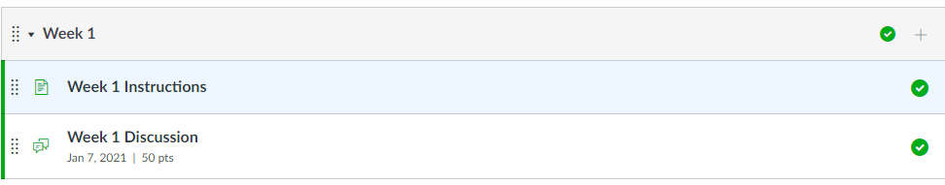
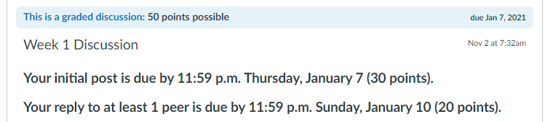
Discussion Post/Response Deadlines
Add to your personal planner
or your Canvas To-do List: https://community.canvaslms.com/docs/DOC-15244-4212947404

Slide 7
1. Respond to all parts of all prompts
2. Number your responses to match the prompts e.g., 1a, 1b, 2a, 2b, 3
In your initial post, respond to each of the following prompts. To save space, do not copy instructions, just identify each response with the corresponding prompt (e.g., 1a, 2b, etc.). You must post before you can see what your peers have posted.
1. (a) Identify and describe a breath- or body-centered practice you want to experiment with this week as you do the readings and participate in forum discussions (b) describe how your practice helps you track how you experience stress in your body, the emotions associated with such stress, and what it feels like when your nervous system shifts from a stress response to a relaxation response. (100-200 words)
2. (a) Use the reading from Doehring to describe how this course could be helpful professionally and/ or personally in making spiritual care a more intentional part of your life and/or vocation. (b) Support your comments with at least 1 quote from Doehring's text. You only need to use a parenthetical reference for the textbook. Format: (Doehring, 2015, p. #). (100-200 words, excluding quote)
3. Describe how/why one or more Course Learning Outcomes may be challenging for you to learn and practice. (~100 words)

Slide 8
Write in complete sentences and use good grammar.
No emojis.
Do not use a casual, conversational tone, as you might in a text or email to a friend.

Slide 9
Be Concise
COFFEE

Slide 10
Spiritual Care Conversations
You will have the opportunity to practice being the spiritual caregiver in one conversation.
You will be the care seeker in the other conversation.

Slide 11
Spiritual Care Conversations
W4 Spiritual Care Conversation Assignment: Find a partner
W5 During our gathering days classes you will meet you’re your partner and record two conversations of approximately 15 minutes each (one in which you guide the conversation as the care giver; the other in which you share an experience as the care receiver
W7 Record two 15 to 20-minute spiritual care conversations with your learning partner. In one conversation, you will be the spiritual caregiver, and in the other conversation, you will be the spiritual care seeker. This conversation will be a sequel to your week 5 conversations, with an opportunity to further explore calming spiritual practices, as well as values and meanings about your experience.
W8 Spiritual Care Conversation Reflection Assignment: how you did/did not demonstrate course learning outcomes in this spiritual care conversation. Upload your spiritual caregiver video and your reflections to (1) the Week 8 Assignment and (2) to the Week 9 Spiritual Care Discussion Group Page
W9 Read the three assignments of your discussion group participants (including your partner’s). Post your reflections to the Week 9 Discussion Forum

Slide 12
Spiritual Care Conversations
Notice when you should post/respond as the care seeker and when you should post/respond as the caregiver!

Slide 13
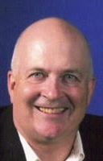

Gathering Days Classes with Carrie and Jeff
Wed., Oct. 13,
1 - 5 pm;
Thur., Oct. 14,
8 a.m. - noon

